Slide 1
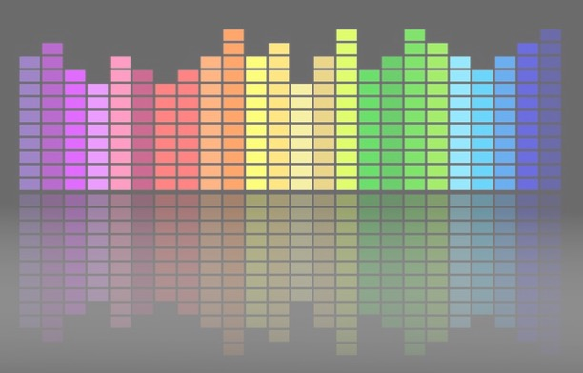

Computational Music Analysis: Audio
A.K.A. “Audio Content Analysis”
1. Course Introduction
Claire Arthur
Noël Alben

Slide 2
Introduction
Your instructors
Y’all ☺
Overview of the course
Materials: What & Where
Day 1: Listening activity

Slide 3

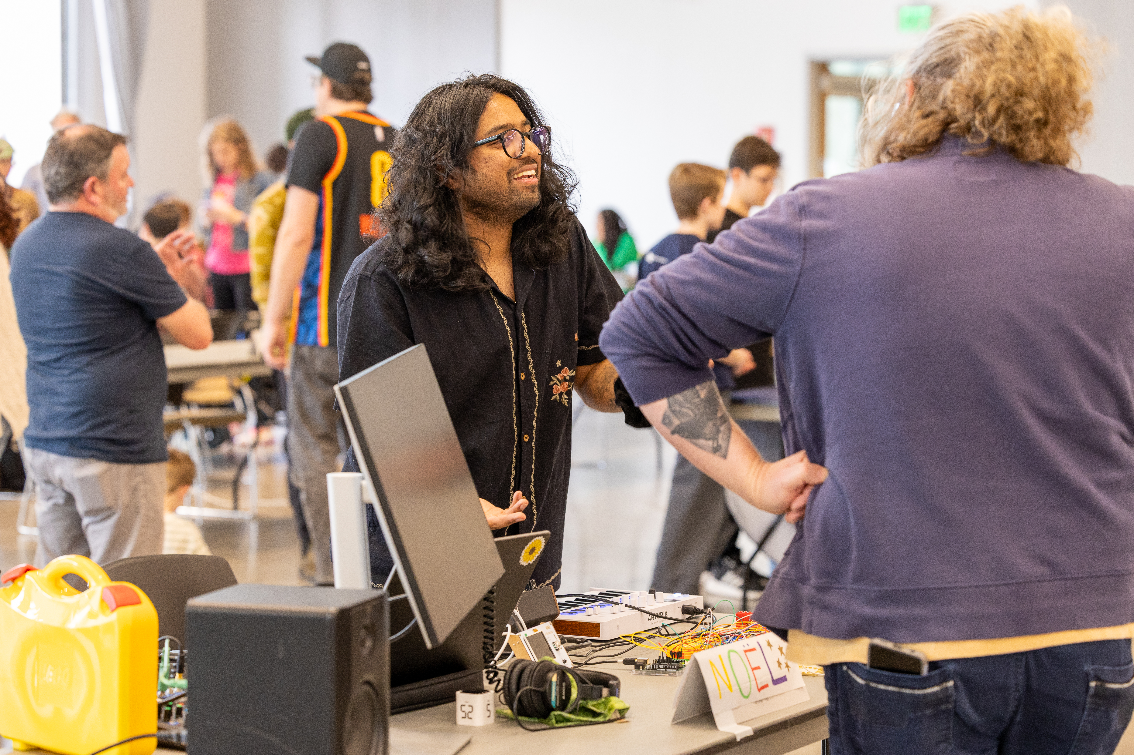








Your Instructors: CCML superteam & trivia host masters
Claire Arthur
Noël Alben

Slide 4
Your Instructors: CCML superteam & trivia host masters
Claire Arthur
PhD in Music Theory & Cognition (Ohio State)
Postdoc in Music Technology (McGill)
Faculty at GT since 2018
Trained as classical pianist (now very bad!)
Now learning cello (even worse!)
Loves when: you are engaged and really trying
Hates when: you yuck other people’s yum

Slide 5

Your Instructors: CCML superteam & trivia host masters
PhD student (Music Education Research)
Masters in Music Technology (GTCMT)
Been at GT since 2021-23; 24-
Multi-instrumentalist (i.e. likes to hoard instruments)
Now learning Violin (harsh crow sounds!)
Loves when: I get $500 off on Reverb
Hates when: you yuck other people’s yum
Noël Alben

Slide 6
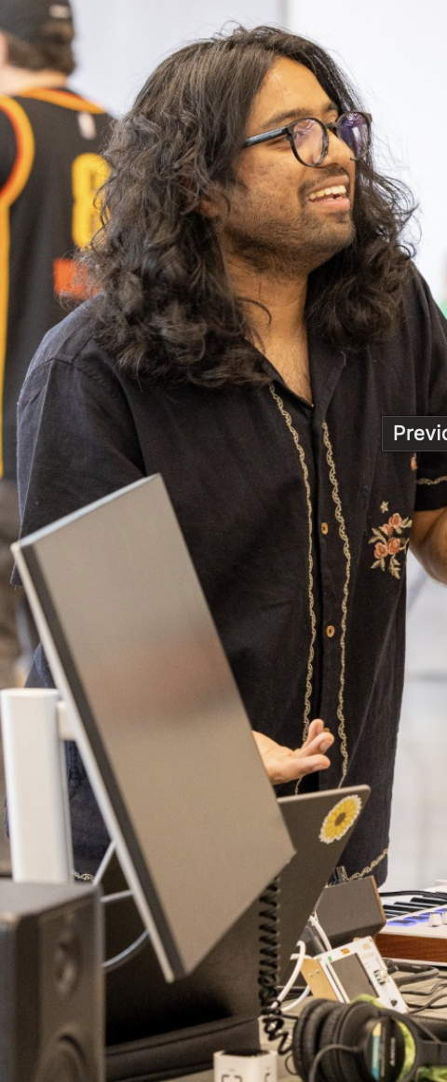




Your Instructors: CCML superteam & trivia host masters
Claire Arthur
PhD in Music Theory & Cognition (Ohio State)
Postdoc in Music Technology (McGill)
Faculty at GT since 2018
Trained as classical pianist (now very bad!)
Now learning cello (even worse!)
Loves when: you are engaged and really trying
Hates when: you yuck other people’s yum
Noël Alben
PhD student (Music Education Research)
Masters in Music Technology (GTCMT)
Been at GT since 2021-23; 24-
Multi-instrumentalist (i.e. likes to hoard instruments)
Now learning Violin (harsh crow sounds!)
Loves when: I win trivia
Hates when: you yuck other people’s yum

Slide 7
Y’all ☺
Some of you…
Have a lot of programming experience and some have a little
Have a lot of musical/theoretical experience and some have a little
Have worked with audio & some of you have not.
Are “math folks” and some of you are not.
Some of you are visual learners, others learn by doing
Grew up speaking English, others recently learned it.

Slide 8
About you 1 min max!!!
Name
Instrument
Where you are from
What do you hope to learn from this class?

Slide 9
Course Overview
Python-based class (expect to spend extra time catching up if this is new or unfamiliar)
Introduction to the topics in Music Information Retrieval for Audio content extraction and analysis
Lots of hands-on practice, exposure to applications
Mix of traditional and more modern methodologies
Project-based course
Assignment heavy
Mostly paired/group work (some assigned, some choice)

Slide 10
Course Goals
After successful completion of this course, you will:
have a good overview of typical tasks in MIR
understand algorithmic approaches in several basic MIR systems
Understand the pros and cons of algorithms vs ML and deep learning for MIR
be able to implement MIR systems in Python
be able to formally evaluate systems with common datasets and metrics

Slide 11
Materials
Everything on Canvas! Check regularly!!
Reading/reference material links
Assignments & due dates
Class materials uploaded each week
Audio files for class activities or assignments
Discussions

Slide 12
Policies
Attendance
Homework, Extensions, & Turning things in late
Missed quizzes
Partner/group work
Participation
Struggling

Slide 13

Group Activity
We are going to listen to a series of short clips
For each clip:
Individually:
you will write down your guess of the genre (typical ‘main’ genres only)
Write down any cues from the music you think you used to classify it.
As a group:
Discuss whether you agree on the genre
Compare notes on your cues
Prompts for overall group discussion:
Are your cues easily translatable to a computational definition?
What might make genre classification easy or challenging?
What kinds of features do you think would be useful in genre classification?

